Slide 1




CUSTOMER SEGMENTATION
Submitted By :
Submitted To :
Kothakota siva prasad reddy
Exposys Data Labs
Kothakota.developer@gmail.com

Slide 2
Introduction
The project is all about customer segmentation which helps to divide or categorise data containing the age , gender, annual income and spending of customer into several groups so that each customer in similar group have similar interests.
Different businesses are always in a race to increase profits and attract more customers which depends on customer satisfaction.
K-means clustering algorithm was used to build the model for segmentation.

Slide 3
Implementation
Required libraries and data are imported
Analysing the data (such as checking for null values , outliers etc…) and plotting different graphs and sketches to observe the patters and distribution of data.
Selecting the proper k value for better model using elbow method.
Implementing the model and evaluating model performance using evaluation metrics.
Plotting the clusters.

Slide 4
Tools and libraries used
Tools used to build the model is jupyter notebook using python language.
Different libraries are used to different purposes.
Pandas :-for basic operations such as importing data and analyse simple arthematic operations over data
Numpy :- for complex calculation over data.
Matplotlib:-for plotting graphs to find relation and distribution of data.
Scikit-learn :-to implement model

Slide 5
Data set
The data set enables the deeper understanding between customers and the organization . companies employing customer segmentation operate under the fact that every customer is different and that their marketing efforts would be better served if they target specific, smaller groups with messages that those consumers would find relevant and lead them to buy something.
Customer id | Gender | Age | Annual income(k$) | Spending score(1-100)
1 | male | 19 | 15 | 39
2 | male | 21 | 15 | 81
3 | female | 20 | 16 | 6
4 | female | 23 | 16 | 77
5 | female | 31 | 17 | 40

Slide 6
Customer id :- it is the unique identification number for each customer
Gender :- gender of customer
Age:- age of customer
Annual income(k$) :- annual income of customer
Spending score: it is the score (out of 100) given to a customer by the mall authorities, based on the money spent and the behavior of the customer.

Slide 7
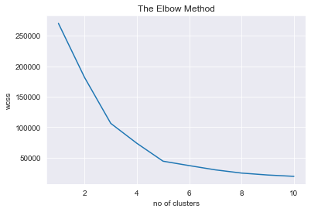
Elbow method
In clustering analysis , the elbow method is a heuristic used in determining the number of clusters in a data set . the method consists of plotting the explained variation as a function of the cluster ,and picking the elbow of the curve as the number of clusters to use.

Slide 8
K-MEANS ALGORITHM
K means clustering algorithm computes the centroids and iterates until we it finds optimal centroid. It assumes that the number of clusters are already known. It is also called flat clustering algorithm , the number of clusters identified from data by algorithm is represented by ‘k’ in k-means.
Stopping criteria for k-means clustering:
There are essentially three stopping criteria that can be adopted to stop the k-means algorithm:
Centroids of newly formed clusters do not change
Points remain in the same cluster
Maximum number of iterations are reach

Slide 9
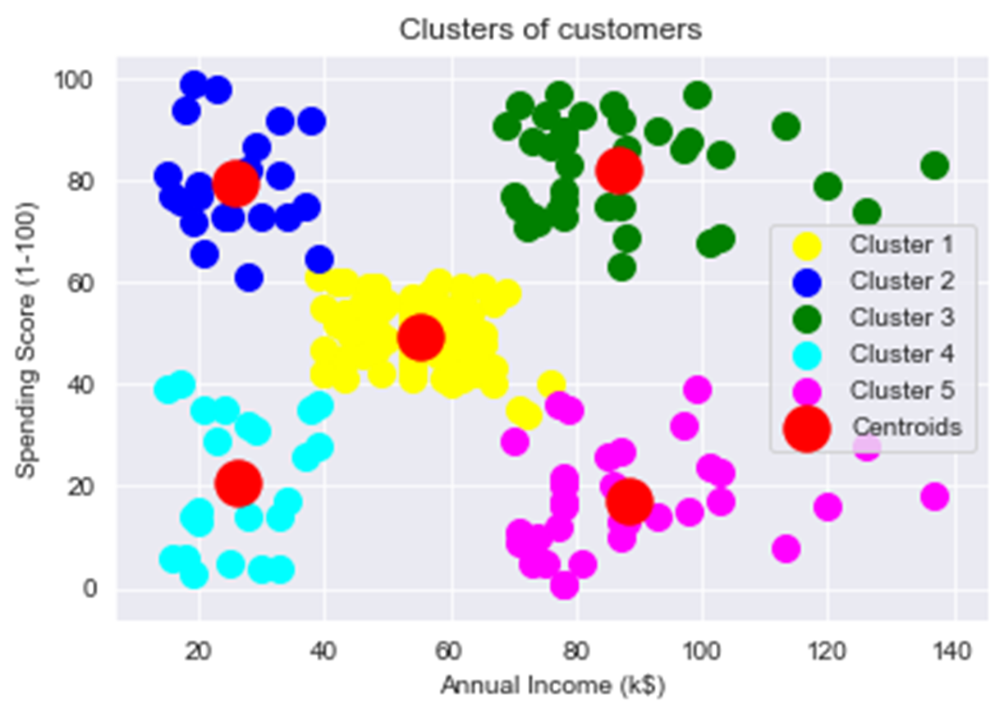

Slide 10
conclusion
In conclusion, the k-means clustering technique is a simple quick algorithm that can be applied to large datasets to separate them into different partitions; analysis of these partitions may provide a better characterization of neck pathologies and may be of additional benefit in distinguishing benign and malignant neck pathologies compared with whole lesion mean ADC alone.
The k-means clustering algorithm is used to find groups which have not been explicitly labeled in the data. This can be used to confirm business assumptions about what types of groups exist or to identify unknown groups in complex data sets.

Slide 11


